Slide 1
Galaxy Web based platform for interactive genome-analysis
http://main.g2.bx.psu.edu/
Hot Topics: Galaxy

Slide 2
Outline
Introduction. Why Galaxy
The interface
Data Upload
History
Text manipulation and format conversion tools
Genomic analysis tools: examples
Get 500bp upstream of a gene set: dataset 1
Overlap dataset 1 with DNA hypersensitivity regions
Retrieve sequences for dataset 1
Other tools
Live examples
Liftover
Map a set of TFBS
Hot Topics: Galaxy

Slide 3
What is Galaxy
A web based platform for analysis of large genomic datasets
No need of programming experience.
Integrates many tools within one interface:
Easy retrieval of data from UCSC, Biomart and other DBs
Powerful text manipulation tools (data preparation)
Filter on columns, join, sort, compute etc
Format conversion tools (text, tab, bed, GFF …)
Integrates tools from other sources. Ex: EMBOSS
MSA tools
Visualize data in UCSC browser.
Next Gen. Seq. Toolbox (beta)
Galaxy frame can be used by other developers
Cistrome (http://cistrome.dfci.harvard.edu/ap/)
(Shirley Liu, Dana-Farber Cancer Institute)
Hot Topics: Galaxy

Slide 4
Documentation and Tutorials
OpenHelix tutorials and exercises
http://www.openhelix.com/cgi/tutorialInfo.cgi?id=82
Galaxy tutorials
http://galaxy.psu.edu/screencasts.html
Galaxy FAQ
http://bitbucket.org/galaxy/galaxy-central/wiki/FAQ
References
Galaxy developers: The Center for Comparative Genomics & Bioinformatics, Pennsylvania State University
Giardine, B., et al. Galaxy: a platform for interactive large-scale analysis. Genome Research (2005) 15:1451-1455
Taylor, J., et al. Using Galaxy to perform large-scale interactive data analyses. Current Protocols in Bioinformatics (2007) Chapter 10, unit 10.
Hot Topics: Galaxy

Slide 5
Galaxy Interface
Data analysis
Log in/out
Processed data
Green:
job is finished
Yellow:
job is running
Gray:
job is in queue
Red: there is a problem
Tools
window
Data display and tool’s dialog window
History window: datasets for each analysis are kept here
Hot Topics: Galaxy

Slide 6
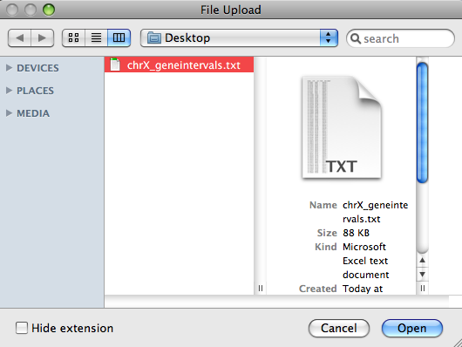
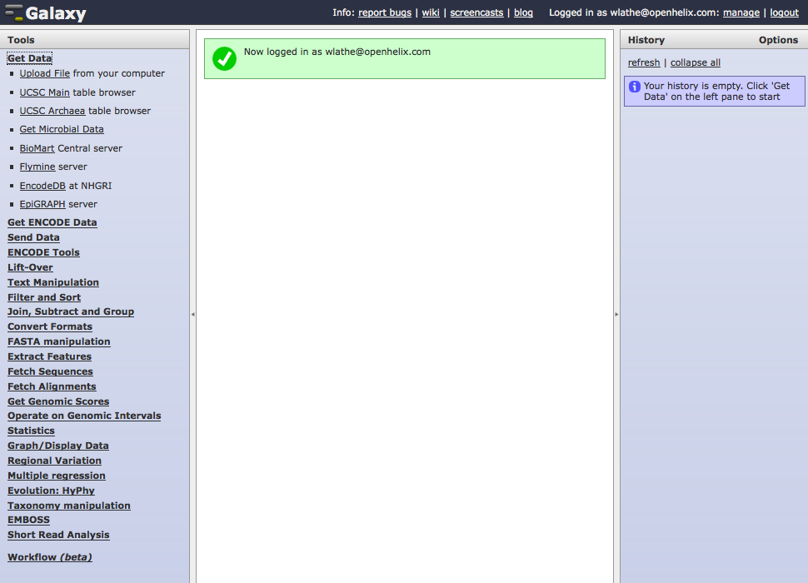
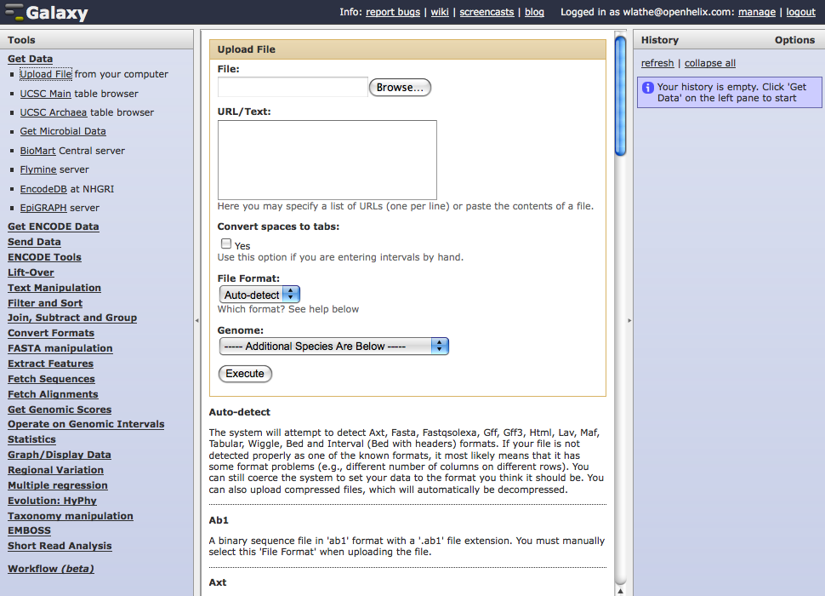
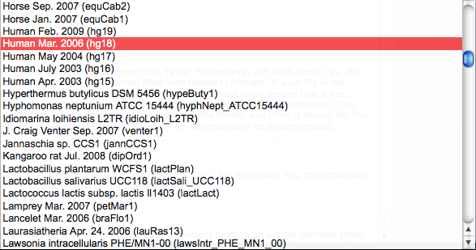
Getting Data: Upload File
Upload File
Upload or paste file
File Format
Species
Execute
Hot Topics: Galaxy
Adapted from OpenHelix tutorial
Notes:
Let’s start by uploading some of our own data.
I’ve prepared a data set of chromosomal locations on the “X” chromosome in the “interval” format. This format is basically a listing of chromosomal locations or intervals in a tab delineated text format, each row having specific purposes (the first being the chromosome, second and third the start and end position, etc). We’ve included a copy of this file on our download site at the URL shown if you wish to try this also. There are many other formats you can upload in. To see an explanation of the formats and how they are built, just scroll down on this page.
To upload your file, you’ll either paste the contents of your file into the window here, or click the browse button here and find the file on your computer. Here I’ve found and uploaded a file from my desktop.
You’ll then choose which file format the file is in. In this case it is in the interval format, but as you see there are many other possible formats. You can also choose “Auto-detect”, which works pretty well to determine the format of a data file if you are not quite sure of the format, or even if you just don’t want to look for the format type on the list.
Once you’ve chosen the file format, you choose which species the data has been obtained from. There are many to choose from. Ours is from Homo sapiens, so that is what we will choose.
Then click “Execute.”

Slide 7
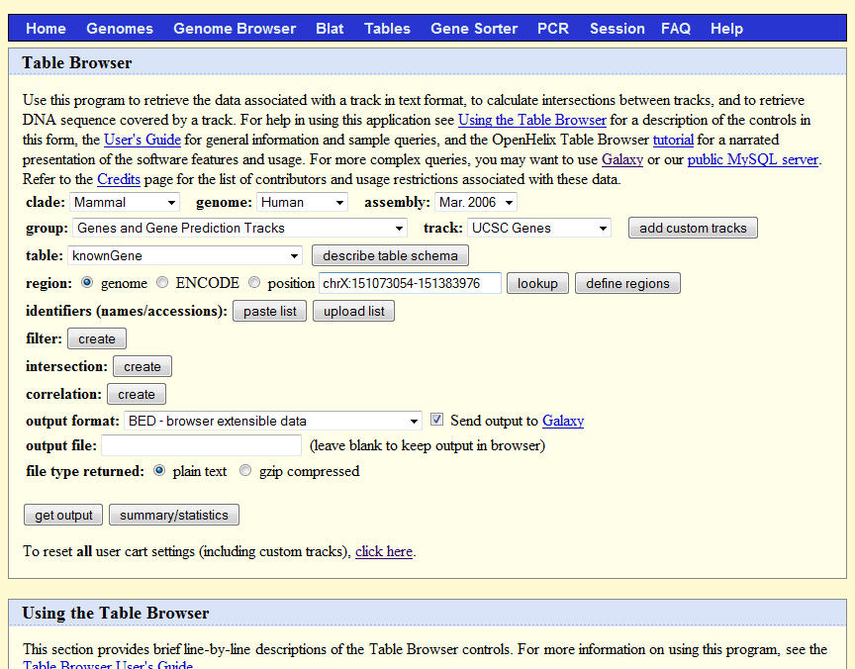
Getting Data: UCSC Table Browser
Get UCSC Data
Hot Topics: Galaxy
Adapted from OpenHelix tutorial
Notes:
Once you click that menu heading, links to various actions will appear. These actions will allow you to obtain, prepare and manipulate and analyze data depending on which menu heading you’ve chosen. Here we have links to various databases from which to obtain data.
We are going to click the link that says “UCSC Main table browser.” This will take us to the UCSC Table Browser, which would show up in the center column here, where we would obtain data and export it here back to Galaxy. We’ll introduce you to the mechanics of that in the next section. Right now, we’ll show you some sample imported data in Galaxy, for a region of the human genome.

Slide 8
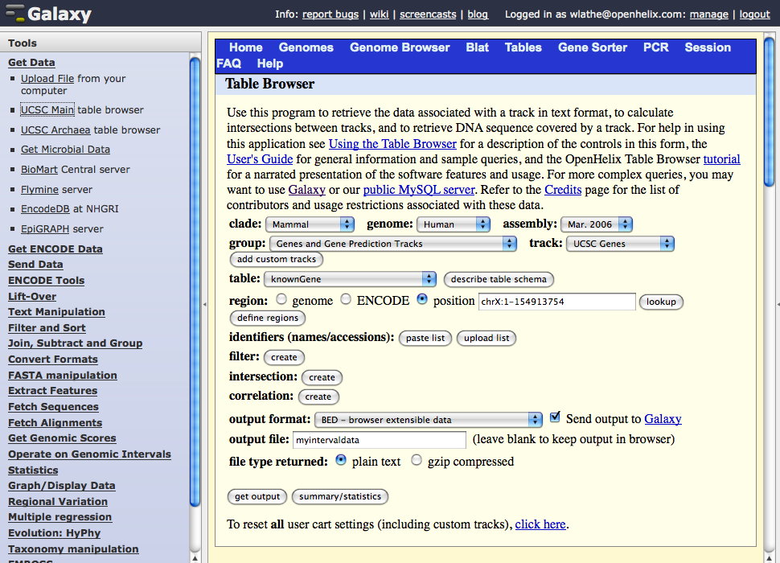
Getting Data: UCSC Table Browser
Get Output
Hot Topics: Galaxy
Adapted from OpenHelix tutorial
Notes:
The Table Browser Interface will now appear in the right hand side.
We are going to get known gene data from the human X chromosome. To do so, we’ll just choose the right data set: Human genome assembly “Mar. 2006” and the “UCSC Genes” dataset from the “Genes and Gene Prediction Tracks” group.
We’ll put the position as “chrX:1-154913754,” or alternatively we could have just written “chrX.”
Leaving all the rest as default, including the output format as BED and the “Send output to Galaxy” checkbox checked, we’ll click the link “Get Output.”

Slide 9
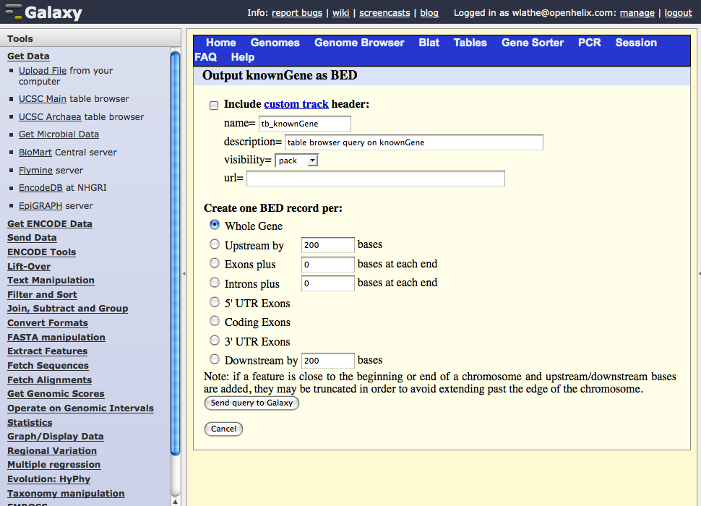
Getting Data: Send Table Results to Galaxy
Send to Galaxy
Hot Topics: Galaxy
Adapted from OpenHelix tutorial
Notes:
We can leave all the next steps with their default settings for our example, but you could create a custom track for the UCSC Genome Browser, and create records for individual gene features here.
We’ll just send this to the Galaxy tool by clicking the “Send query to Galaxy” link.

Slide 10
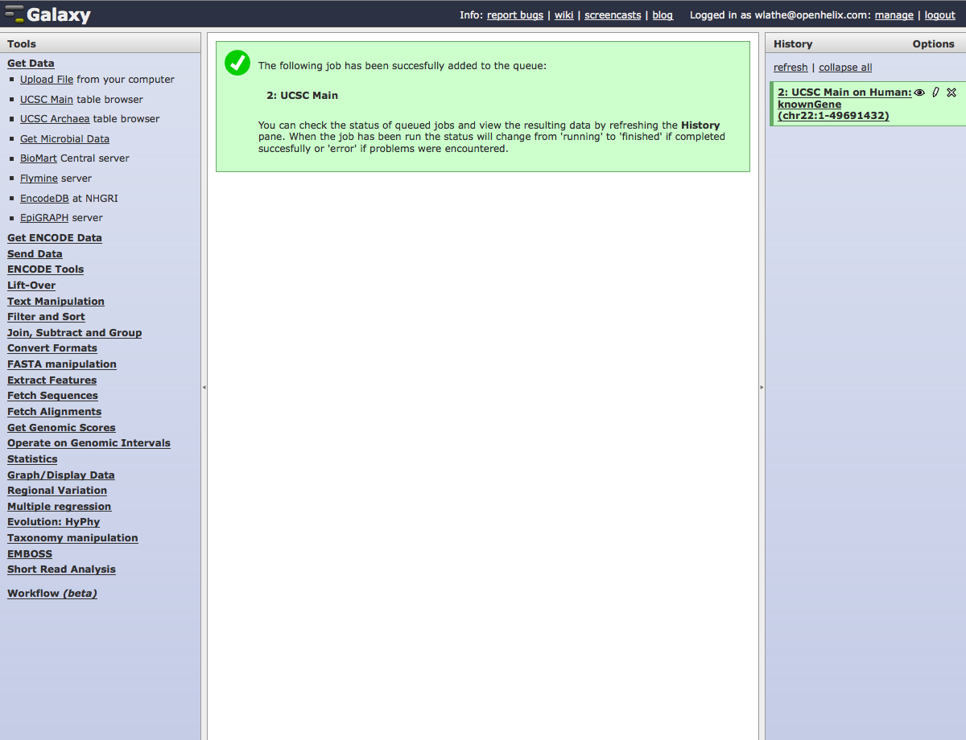
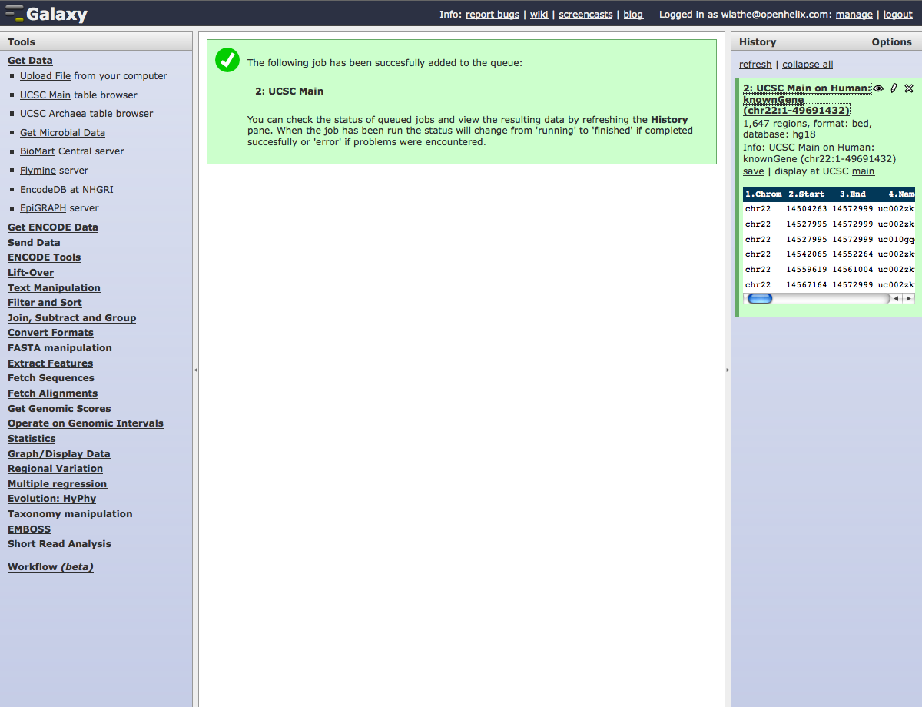
Data Uploaded
View Summary
Hot Topics: Galaxy
Adapted from OpenHelix tutorial
Notes:
You’ll see that once the data has been imported, you’ll receive a message in the middle column to that effect. On the right hand history column, you’ll see your imported data summary.
You can view a summary and sample of the data by clicking the heading link. This will tell you some basic statistics, show an example of the data and the data columns, and have links to give you the ability to view the data or edit the data summary.

Slide 11
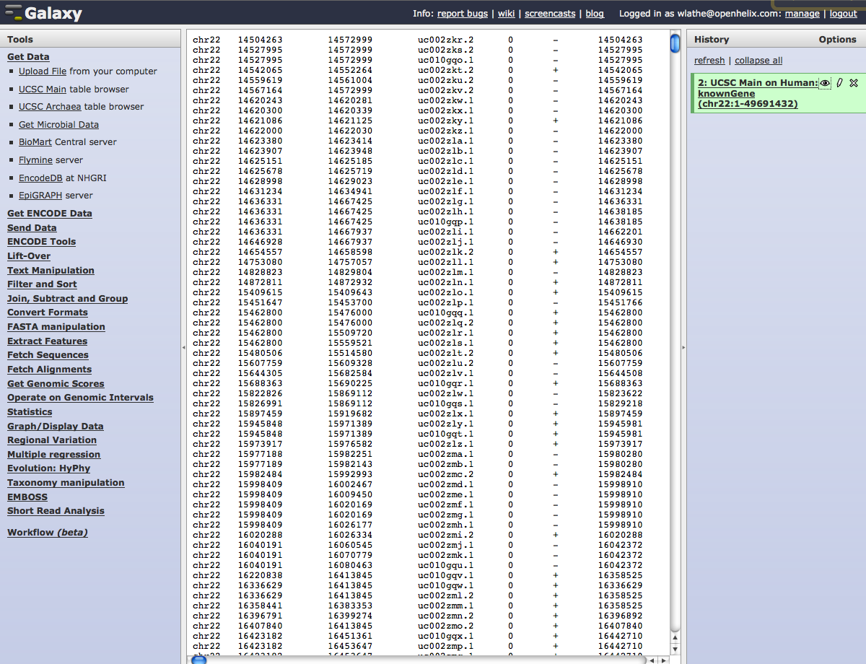
View Data
View Data
Hot Topics: Galaxy
Adapted from OpenHelix tutorial
Notes:
By clicking the “eye” you see here, you can view the data file.

Slide 12
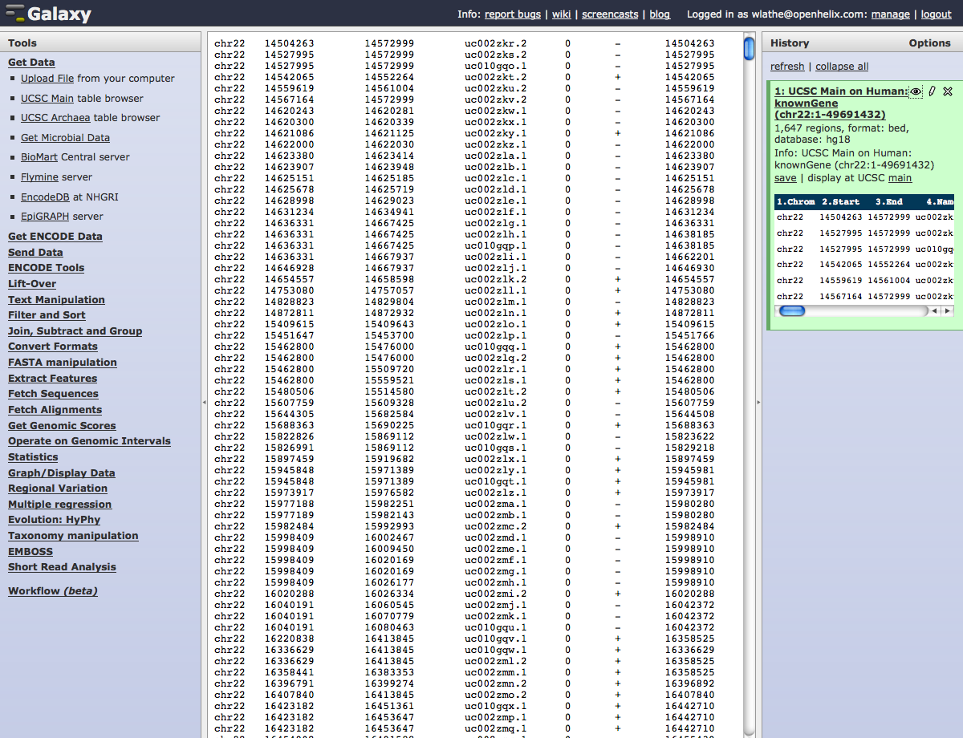
View Data
Edit Attributes
Hot Topics: Galaxy
Adapted from OpenHelix tutorial
Notes:
Once you click this link, the data file will appear in the center column.
You can also edit the attributes of the data file summary by clicking the icon of the pencil you see here.

Slide 13
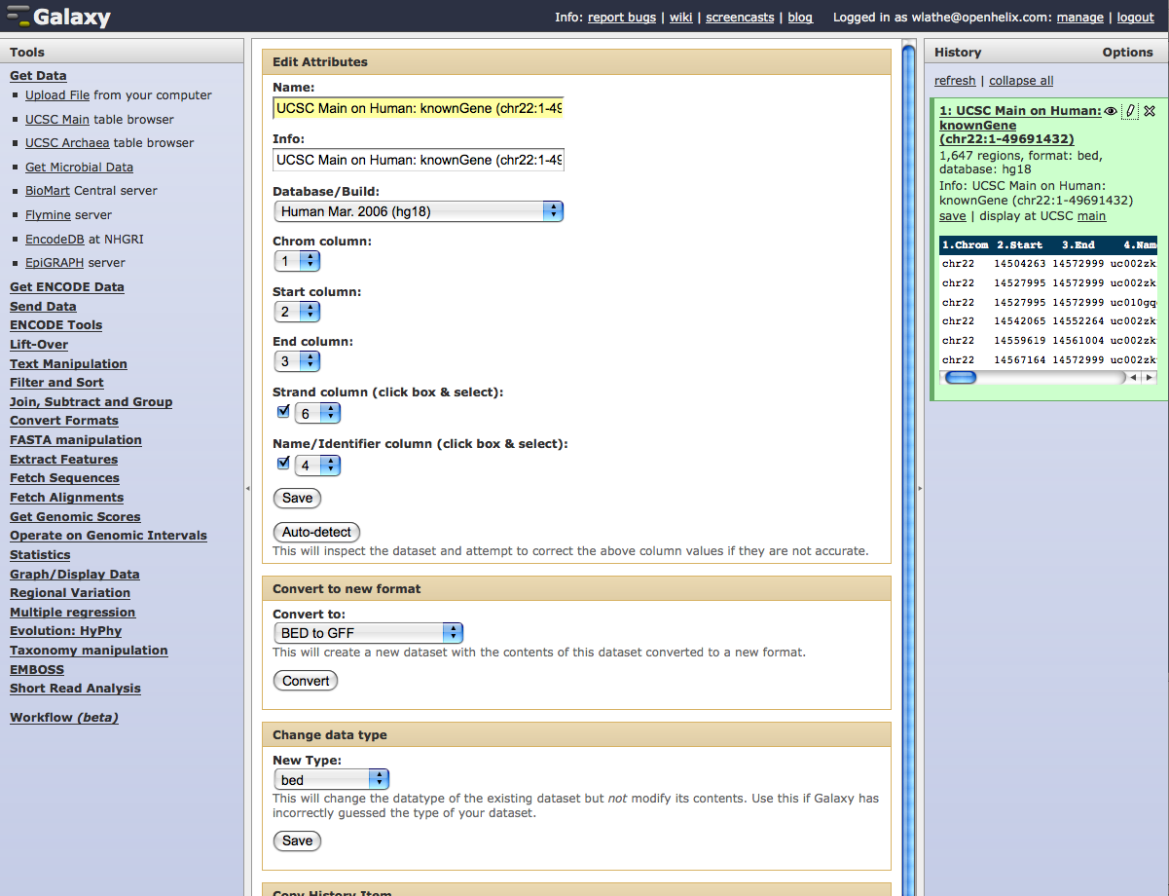
Edit Attributes
Hot Topics: Galaxy
Adapted from OpenHelix tutorial
Notes:
The edit window will now appear in the center column. Here you can edit attributes like the name of the data file, information on how it was obtained, column information and more.
You can also convert this to a new data format, or the designated data type, if the Galaxy software had incorrectly assigned it.
As you upload other data files, modify files you have and perform analyses, each step will show up here in the right column, the “History” column, where our first step is currently showing.
You will have options of actions you can perform on this history. Clicking on the “Options” link here will take you to that menu.

Slide 14
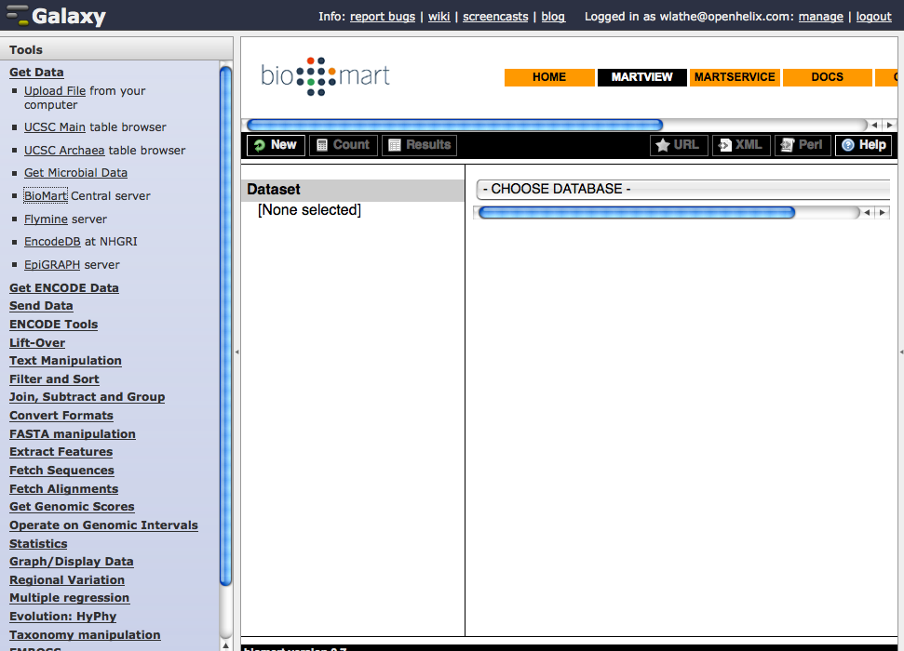
Getting Data: BioMart Dataset
Choose Data
Hot Topics: Galaxy
Notes:
Clicking that link will, as it did for the UCSC Table Browser, take us to BioMart where we can search for, and retrieve the data we need.
We’ll look for the same data we downloaded from the UCSC Table Browser, by choosing the NCBI136 Ensembl Genes.

Slide 15
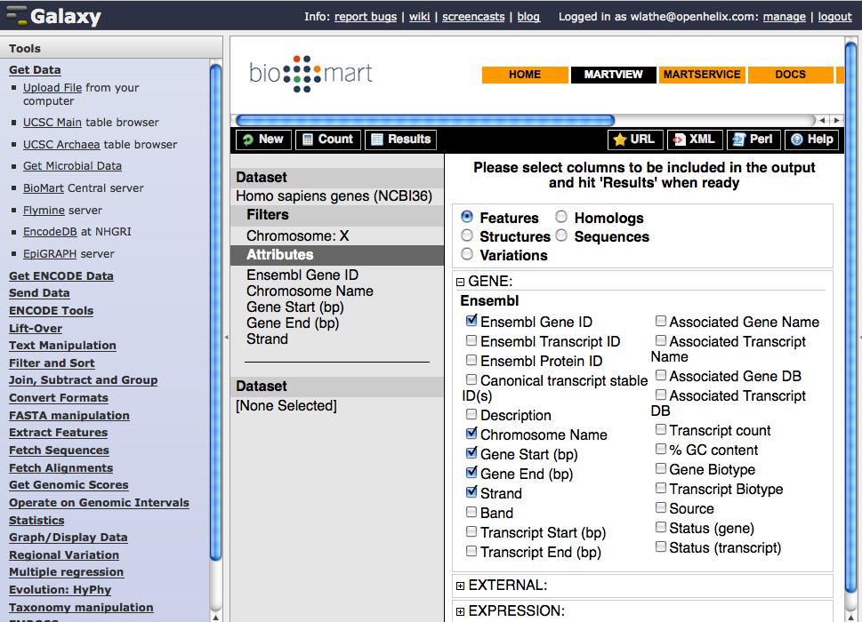
Getting Data: BioMart Data Attributes
Results
Hot Topics: Galaxy
Adapted from OpenHelix tutorial
Notes:
Once we do that, we’ll be able to now filter and choose the attributes we wish to download. For example here we have chosen Ensembl Gene ID, chromosome name, gene start and gene end. For more information about how to use BioMart, check the BioMart documentation.
Click “Results” to see the results.

Slide 16
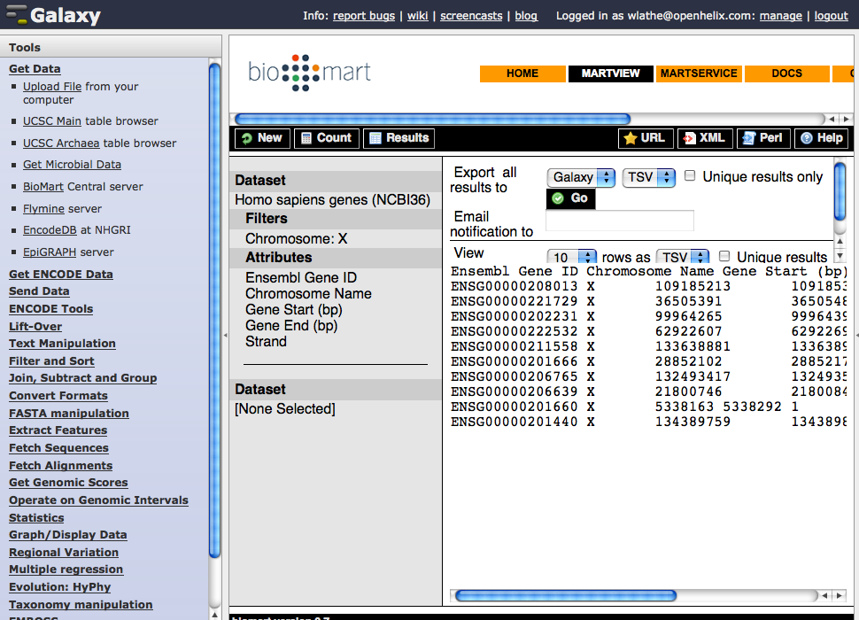
Getting Data: BioMart Results
Send to Galaxy
Hot Topics: Galaxy
Adapted from OpenHelix tutorial
Notes:
You’ll see now your new dataset.
Choose “Galaxy” in the “Export all results to“ pull down menu and click “Go.”
As with the UCSC Table Browser data, the data will be sent to Galaxy for further manipulation and analysis.

Slide 17
History
All steps are saved
Every time we do a new operation a new dataset is created. Data is not overridden
Can share history with other Galaxy user
Can create workflow to repeat an analysis
Hot Topics: What Galaxy can do for you

Slide 18
History
History Options
Saved Histories
Hot Topics: What Galaxy can do for you

Slide 19
History
Hot Topics: What Galaxy can do for you

Slide 20
Text Manipulation
Hot Topics: Galaxy

Slide 21
Convert formats
Hot Topics: Galaxy

Slide 22
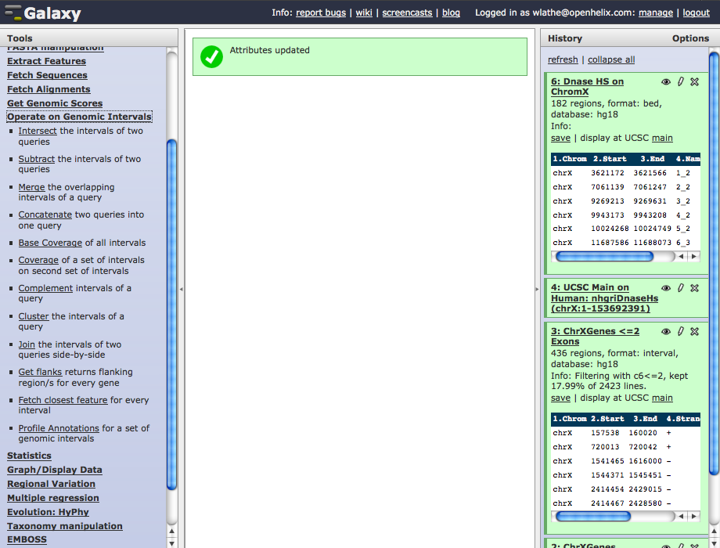
Analyzing Data: Get 500 pb upstream
Get flanks
Hot Topics: Galaxy
Adapted from OpenHelix tutorial
Notes:
Once you have prepared your data, you will have many options to perform further analysis. The number of analysis tools is large and growing, We will only show you a few here. Please note: to retain reproducibility, the analysis tools you’ll find here will always be available at Galaxy, even as new and updated tools are added. Their exact location may shift, however.
“Operate on Genomic Intervals” has many very useful data analysis and preparation tools and we’ll take a look at these in this section using a couple tools as examples.
We will be getting upstream flanking regions from our gene locations and then determining if there are any putative Dnase hypersensitive sites in those flanking regions.
To do this, we will use two tools in this section, “Get flanks…” and “Join….” “Get flanks…” returns upstream and downstream regions of chromosomal locations. Then “Join…” will find locations that overlap between two datasets and return a new dataset of those joined locations with data columns from both original datasets.
Let’s start by clicking the “Get flanks…” link here.

Slide 23
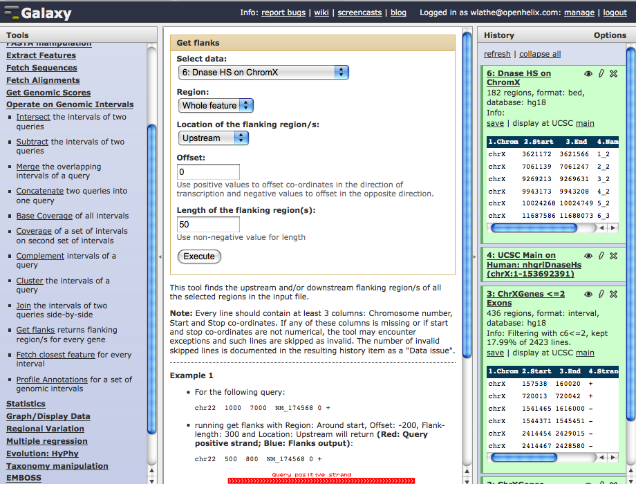
Analyzing Data: Get 500 pb upstream
500
Hot Topics: Galaxy
Adapted from OpenHelix tutorial
Notes:
Once you click that link you will be presented with the form here. Choose the dataset from which you want to obtain flanking regions. Ours is the one we earlier obtained from the UCSC Table Browser, filtered and renamed.
We leave the region from which we want flanking regions at the default “Whole feature,” (we could have alternatively asked for flanking regions of exons or introns, etc.) and we’ll leave the location of the flanking region as “Upstream” (alternatively we could have chosen “Downstream”). We’ll also leave the “Offset” as default.
We will choose to return a flanking region of 500 base pairs here.

Slide 24
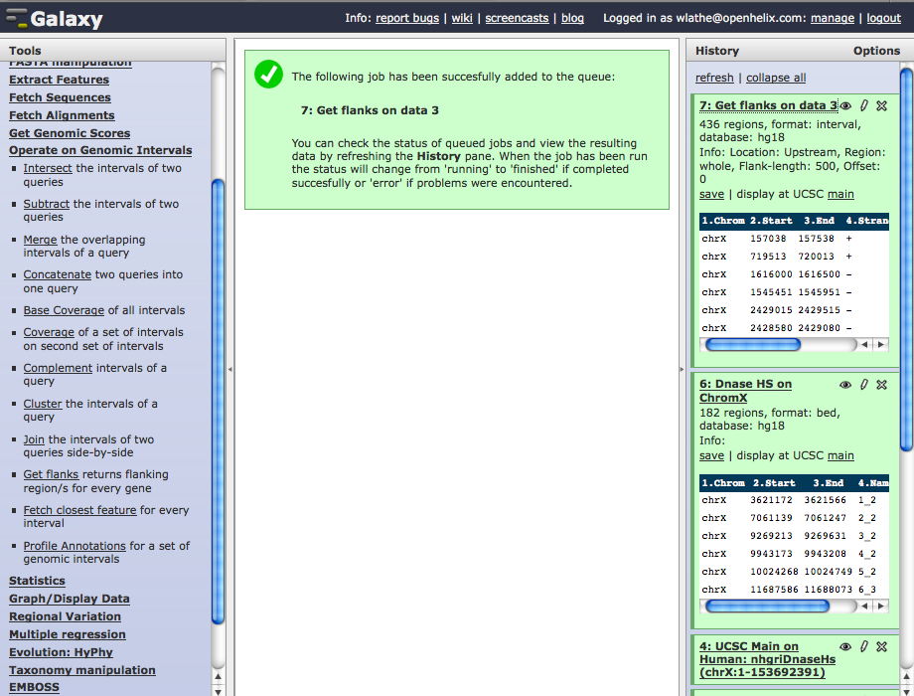
Analyzing Data: Get 500 pb upstream
Execute
Hot Topics: Galaxy
Adapted from OpenHelix tutorial
Notes:
Click “Execute”.
This will return a new dataset of the 500 base pair upstream regions from the gene locations on chromosome X.
Now we can join this dataset with our Dnase hypersensitive sites by clicking the “Join…” link here.

Slide 25
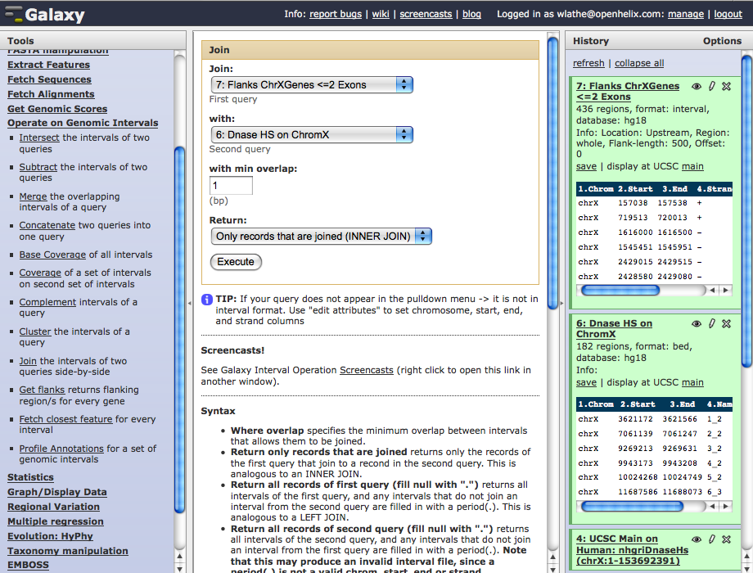
Analyzing Data: Join
Execute
Hot Topics: Galaxy
Adapted from OpenHelix tutorial
Notes:
Once you click that link, you will find this menu. Here you will choose the two datasets in your history that you wish to join.
We’ll leave the minimum overlap as the default of at least 1, but we could have chosen a higher minimum.
We’ll leave the return menu as default to return only those data records that have overlap and have been joined.
We’ll then click “Execute.”

Slide 26
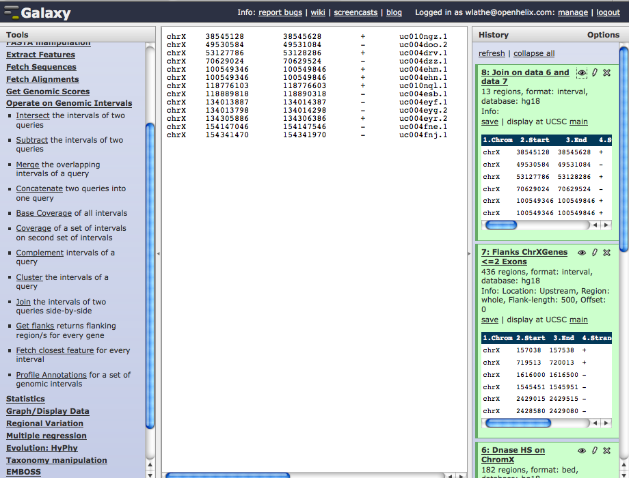
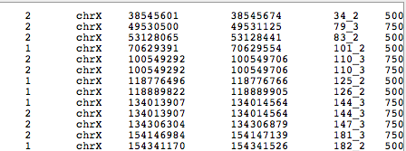
Analyzing Data: Retrieve Sequences
Get Sequence
View
Hot Topics: Galaxy
Adapted from OpenHelix tutorial
Notes:
As you see, our new dataset has 13 upstream regions of genes in the X chromosome. These are flanking regions that have overlap with Dnase hypersensitive sites.
We can view data by clicking the “eye” icon. Here you’ll see the columns of data from the locations that had overlap. The first columns are those of the first dataset with chromosomal locations, strand, name and more. If you scroll over to the right, you’ll see the data columns from the second dataset, the hypersensitive sites, including location, name and score.
You could then analyze this data further by filtering for score or much more. We are going to get the associated sequences. Click the tools heading “Fetch Sequences.”

Slide 27
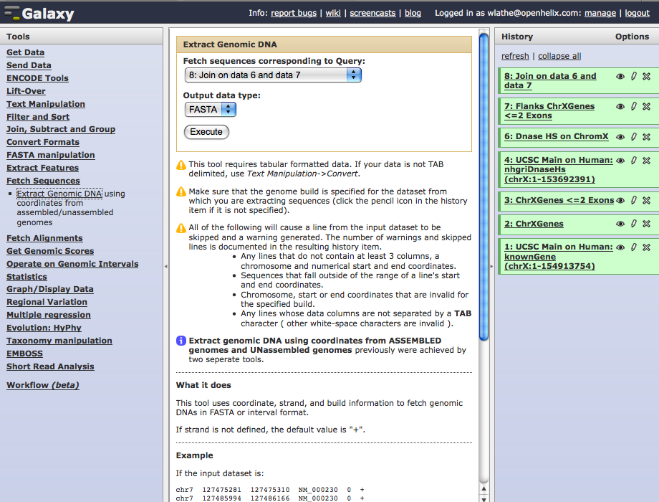
Analyzing Data: Retrieve Sequences
Execute
Hot Topics: Galaxy
Adapted from OpenHelix tutorial
Notes:
This tool, “Extract Genomic DNA…” allows us to do exactly what the name implies - obtain the genomic DNA sequence of these locations. You would choose the data you want to obtain sequence from, and then choose an output format. Here we leave FASTA as our default format and click “Execute.”

Slide 28
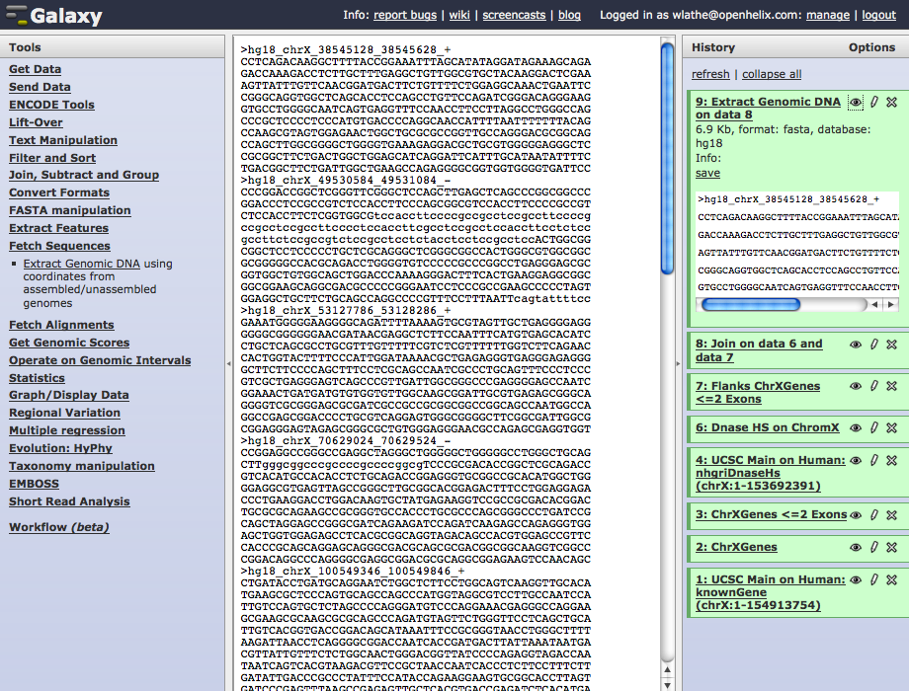
Analyzing Data
Hot Topics: Galaxy
Adapted from OpenHelix tutorial
Notes:
We will then have a FASTA formatted sequence from the locations of the flanking regions. It returns the first reported regions in the dataset.
Many more analysis tools available. There are tools such as statistics and graphing capabilities. The available tools will be constantly growing.
One of the strengths of the Galaxy tool is the ability to save your analyses for future use and to share them with other researchers to aid collaboration and reproducibility.
If you have registered, and again we suggest you do, you can rename and share your analysis histories. Click the “Options” link in the right hand history column.

Slide 29
Operate on Genomic Intervals: Intersect
Hot Topics: Galaxy

Slide 30
Fetch Closest Feature
Hot Topics: Galaxy

Slide 31
ENCODE Tools
Hot Topics: Galaxy

Slide 32
More tools
Hot Topics: Galaxy
Notes:
INMA: highlight some of the tools I have used and I have found useful.
Have 2 saved histories for the examples Liftover and Map TFBS and go through them.

